Slide 1
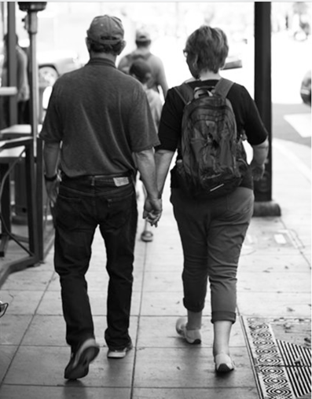

Truths on the Other
Side of Dementia
A Candid Look into Care-Partner Fatigue
Myrna Marofsky

Slide 2
Care Partner
Fatigue
The deep physical, emotional, and mental exhaustion experienced by those who provide ongoing care for a loved one.
It’s the kind of fatigue that comes from constantly giving oneself to others, with little, if any, emotional support in return.

Slide 3
Today’s Session
Share the Five Fatigues experienced by care partners, encouraging them to be kinder to themselves.
Increase awareness for those who provide services, helping them recognize Care Fatigue so they can provide meaningful and compassionate support.
Introduce the Cs of Care-LIVING that ease the emotional and physical burden of caregiving.

Slide 4
Disclaimers
#1
This is NOT based on research.
#3
This is NOT a pity party!
#2
I have NO answers.

Slide 5
The Role
Care partners take on this role with love and grace, yet it is not a job they would have chosen.
In the process, they sacrifice personal needs, interests, and sometimes even their sense of self.

Slide 6

The Five Fatigues on the other side
Fatigue 1 Loss
Fatigue 2 Loneliness
Fatigue 3 Fear
Fatigue 4 Guilt
Fatigue 5 Sadness

Slide 7
Care-LIVING
An empowering choice that reframes “caregiving” from a burdensome responsibility to an intentional choice to keep bad news from becoming a bad life.
A mindset of living lovingly, focusing on what is still possible.

Slide 8


The C’s of Care-Living
Collaborative Care
Compassionate Concern
Communication with Connection.
Caregiving with a Chuckle
1
2
3
4

Slide 9
Greatest Truth
On the other side of Truth is Triumph.
We are not powerless.
We are not alone.
And we are in this together.

Slide 10

.
Be Kind to Yourself!

