Slide 1

JFCS MPLS Hag Sameach 2024 Year in Review

Slide 2

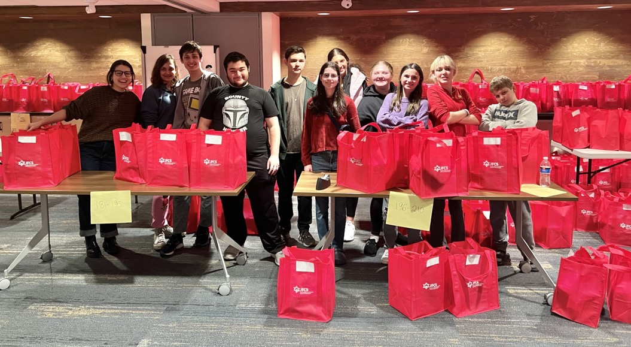
PASSOVER 240 referrals serving 316 individuals
New this year… customized Passover packages!
Recipients could choose:
A full referral
Selecting which items they want to receive
Low sodium
Gluten-free
Over 100 of the 240 referrals customized their package!

Slide 3
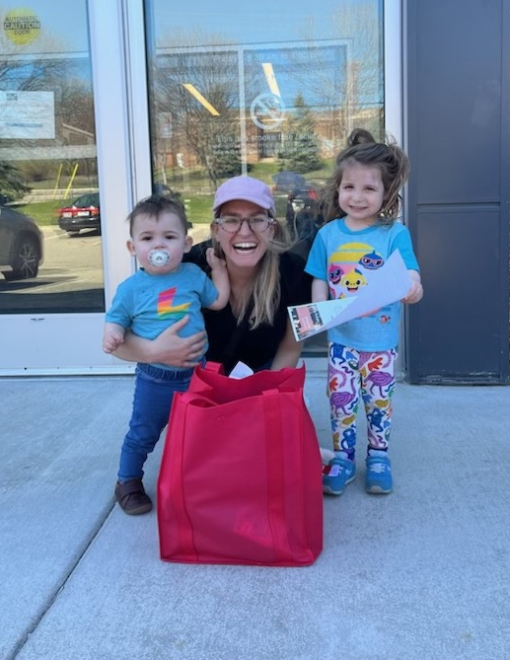
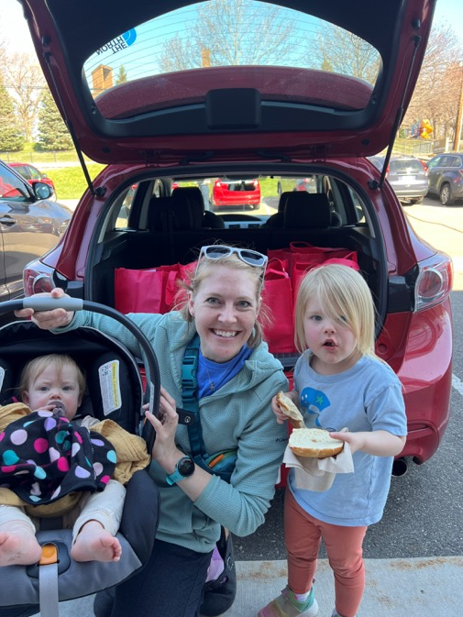

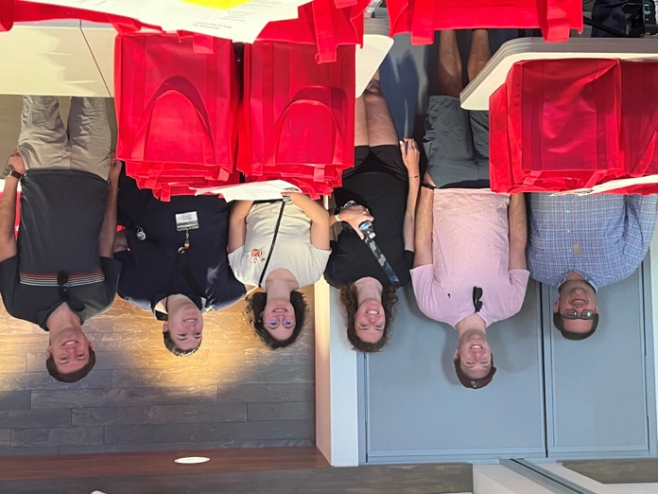
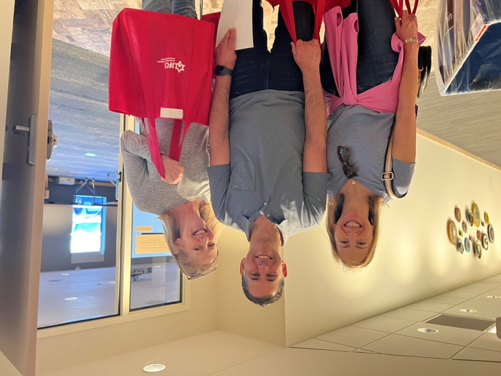
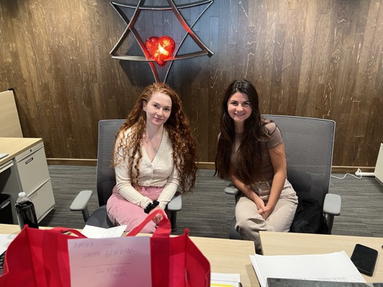
Our pilot program for delivery visitors was a wonderful success and enjoyed by everyone who participated

Slide 4


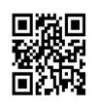
High Holidays postcard sent to clients of JFCS
Jewish Holidays 5785
2024
2025
ROSH HASHANAH
PURIM
begins at sundown on
begins at sundown on
October 2
March 13
YOM KIPPUR
PASSOVER
begins at sundown on
begins at sundown on
October 11
April 12
SUKKOT
SHAVUOT
begins at sundown on
begins at sundown on
October 16
June 1
SIMCHAT TORAH
begins at sundown on
October 24
CHANUKAH
begins at sundown on
December 25

Slide 5

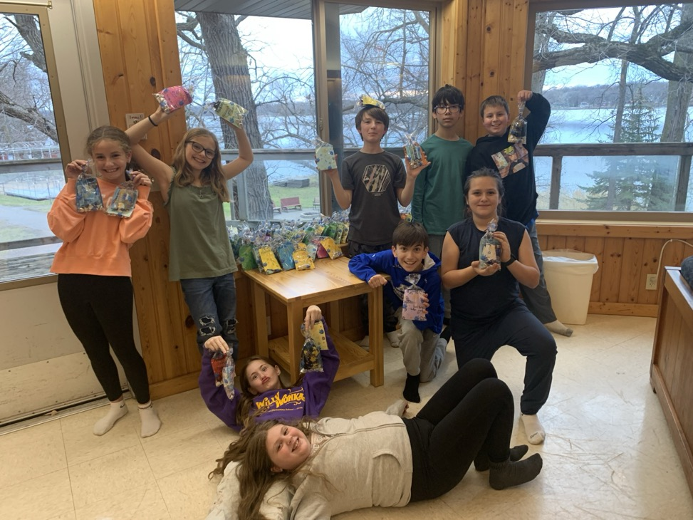
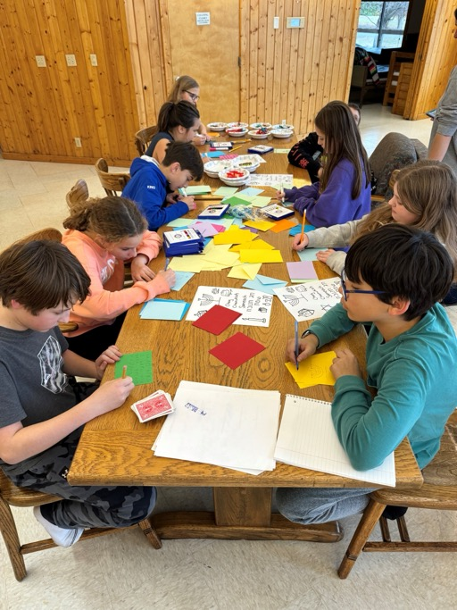
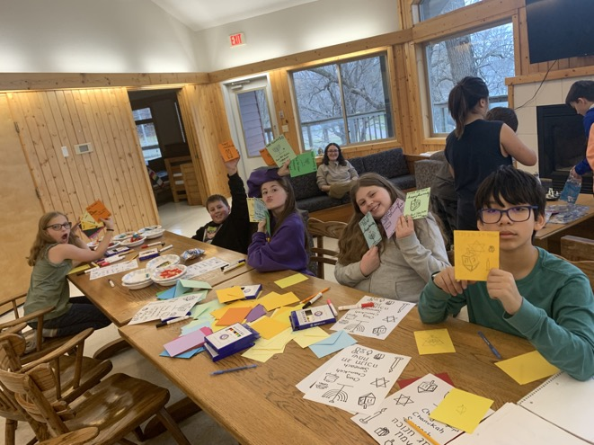

Gift Assembly
7th graders assembling and decorating gifts

Slide 6

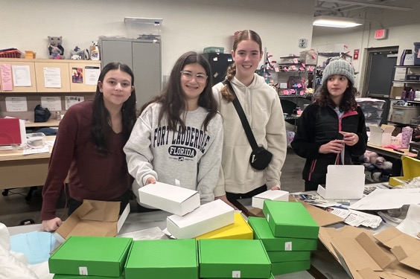
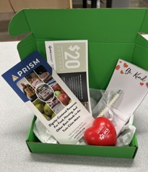
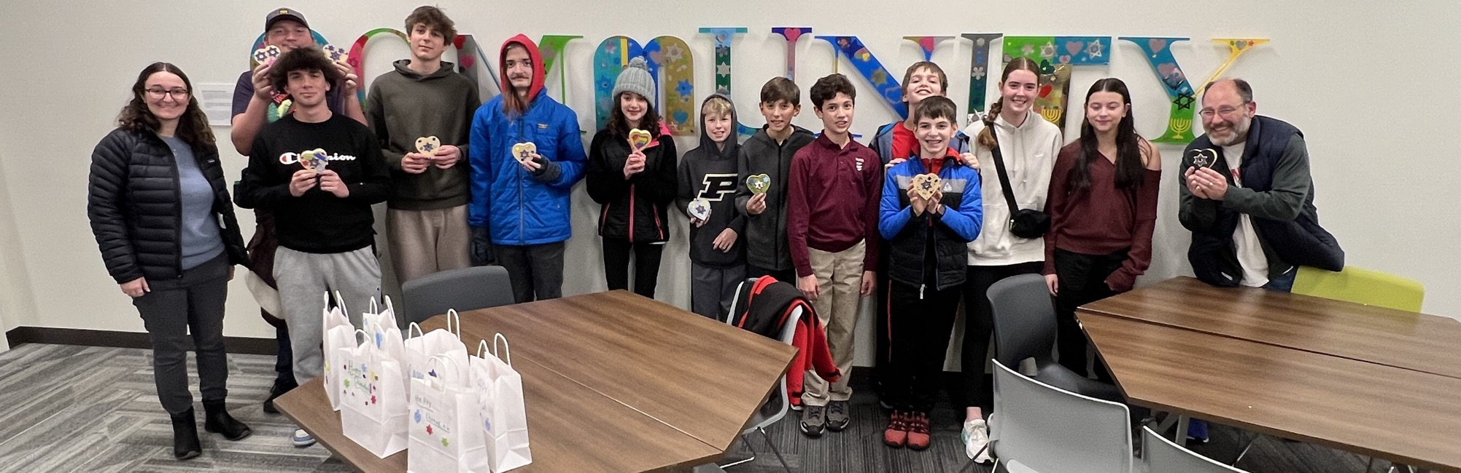
Bet Shalom youth decorating candy boxes and assembling clothing voucher gifts for recipients to use at PRISM
Gift Assembly

Slide 7

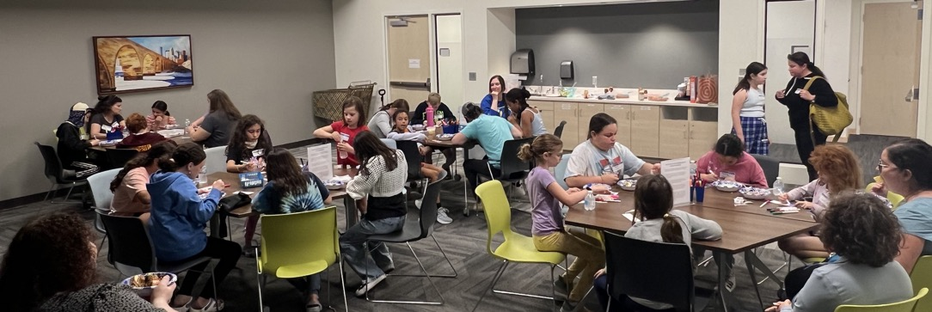

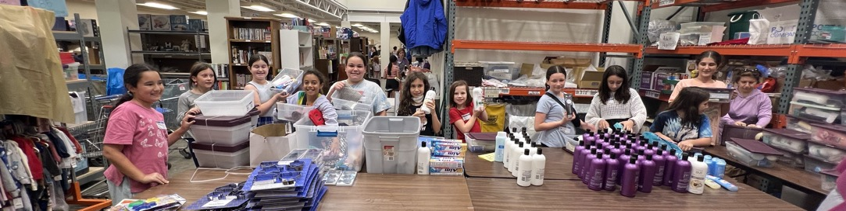
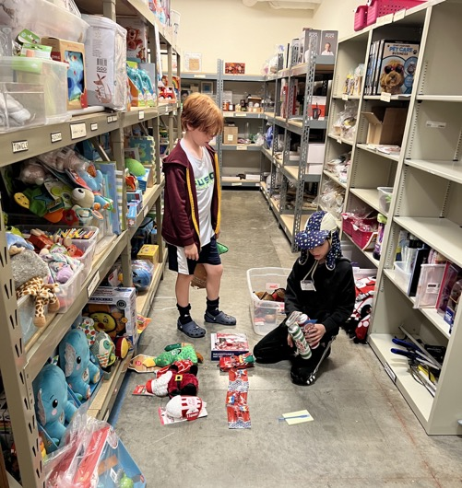
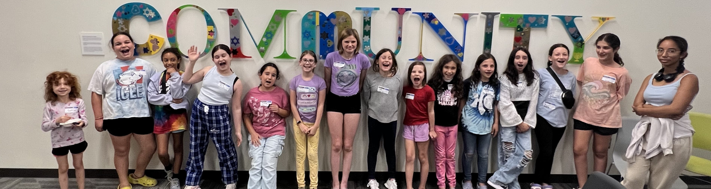
Gift Assembly
Assembling toiletry bins, warehouse inventory, decorating and more!

Slide 8
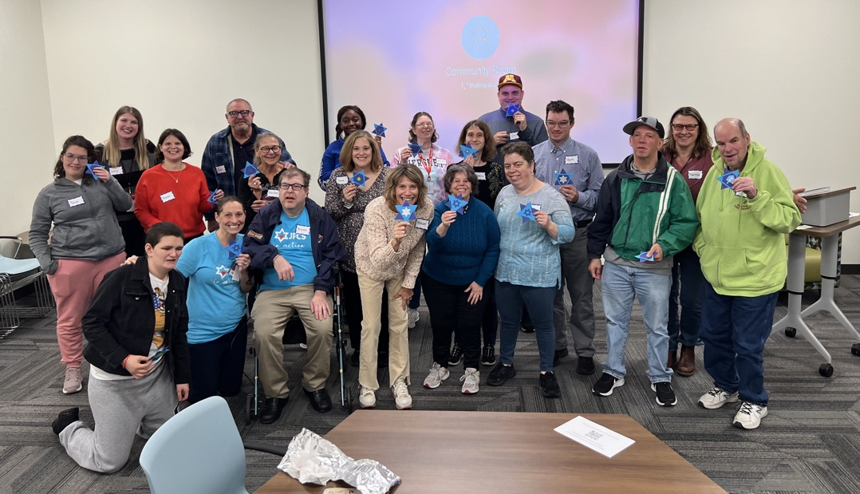
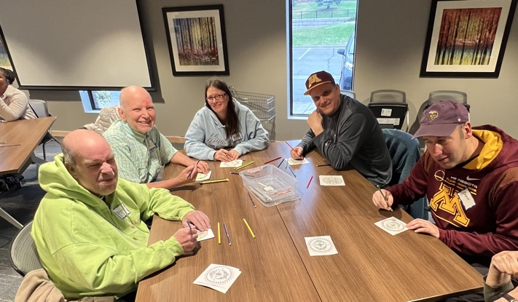
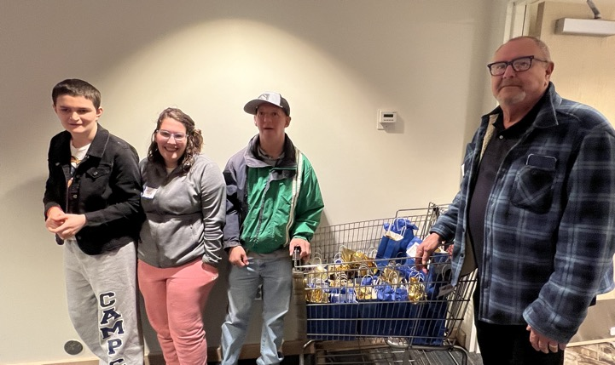
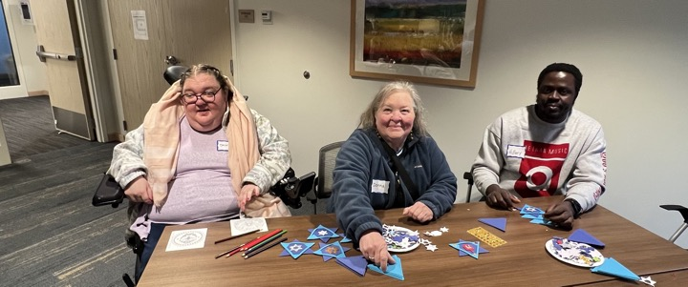
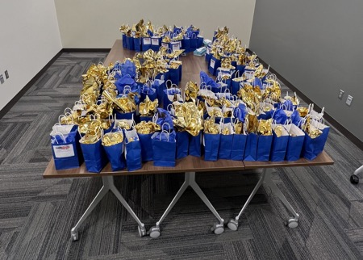
Caring Connections participants assembled mitzvah bags, gift wrapped and decorated gifts!
Gift Assembly

Slide 9

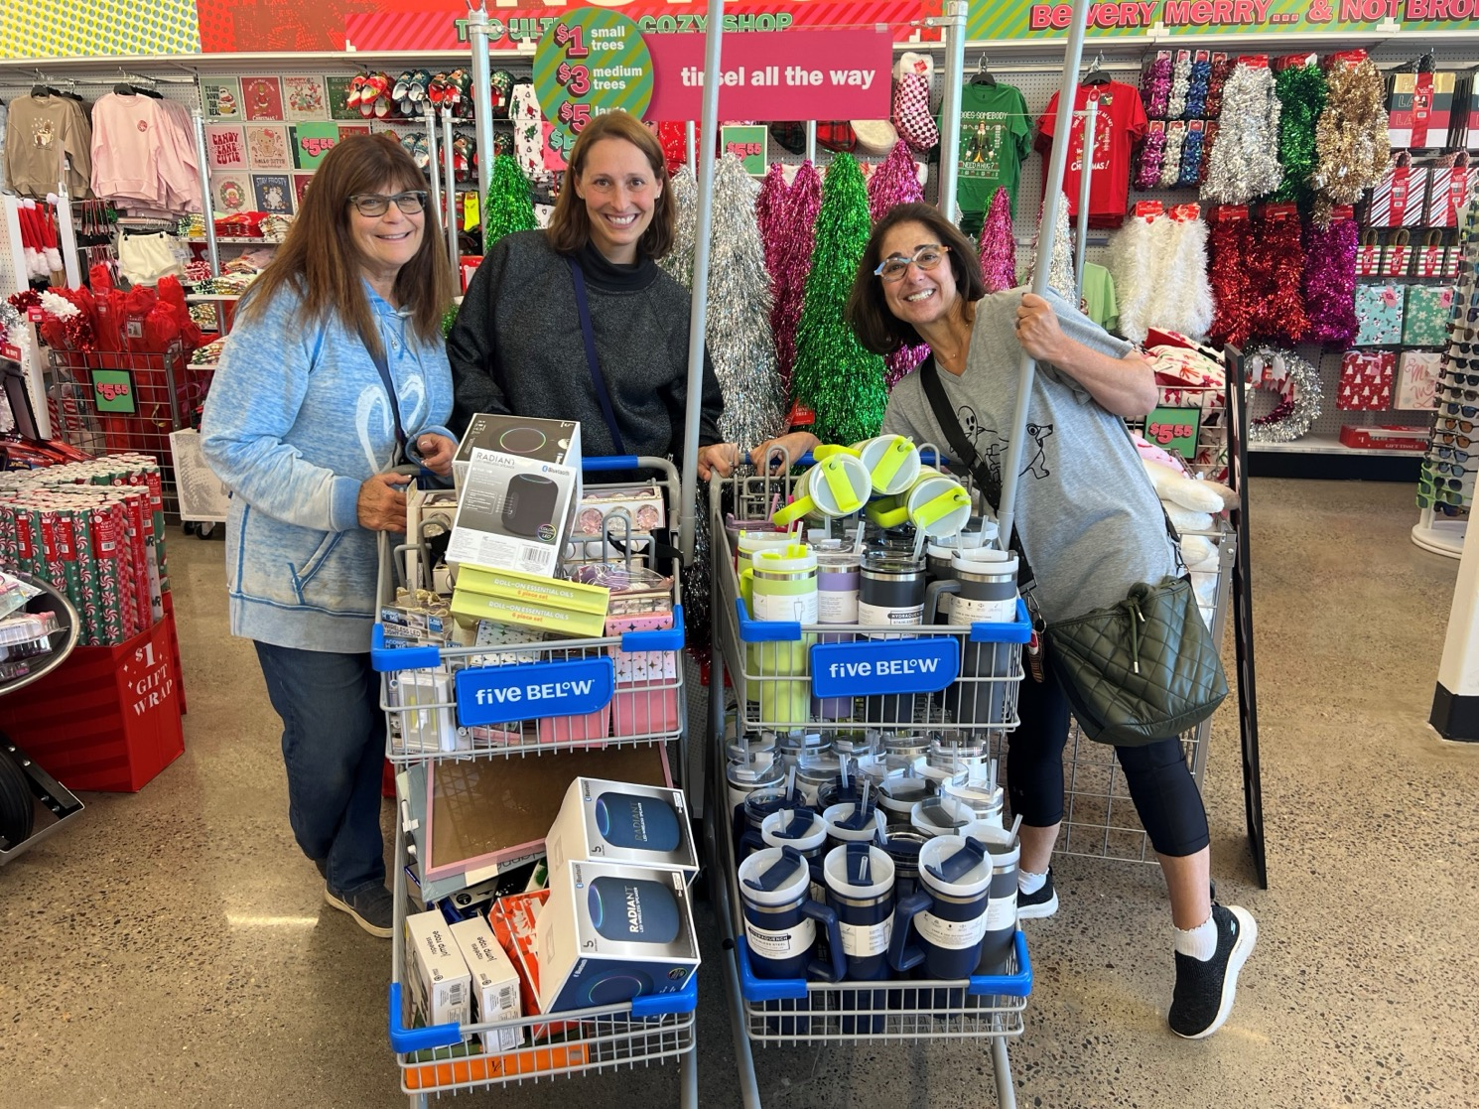

Slide 10

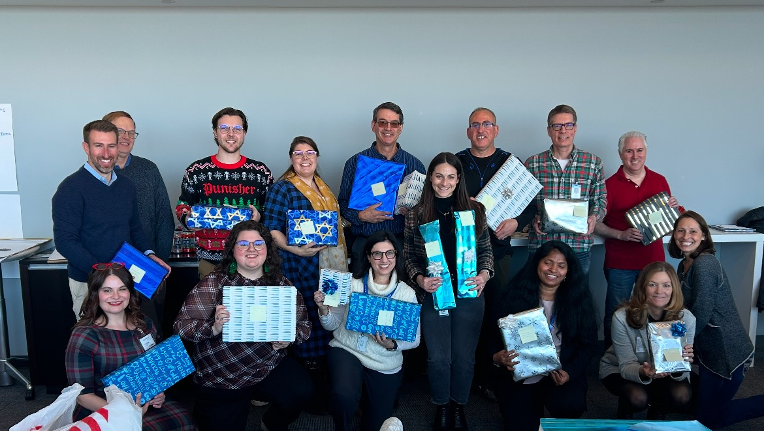
Medtronic Jewish Community (MJC) Employment Resource Group (ERG) Chanukah Party
Donations

Slide 11


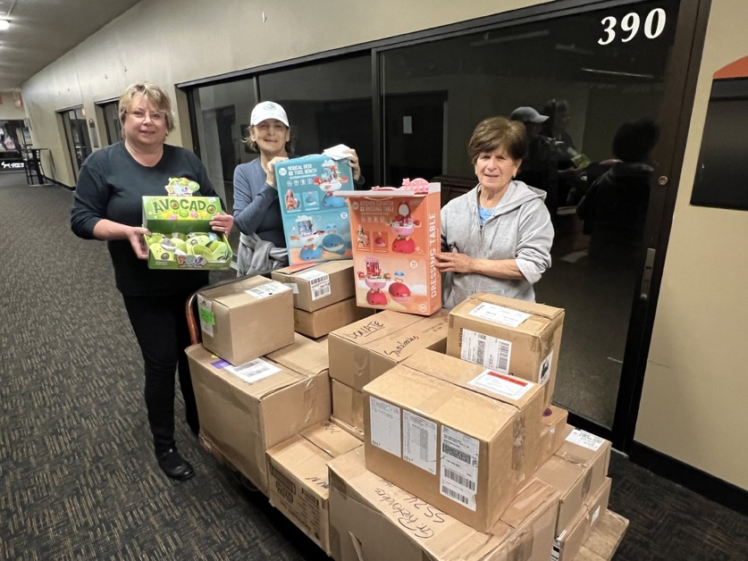
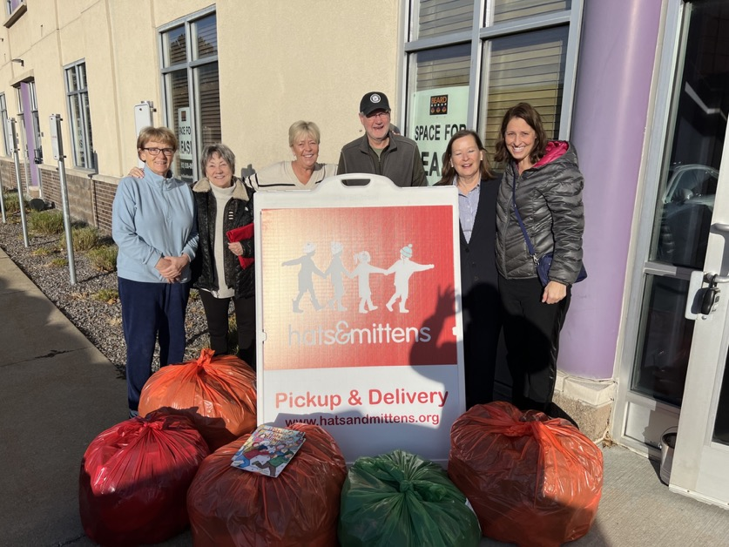
Donations

Slide 12
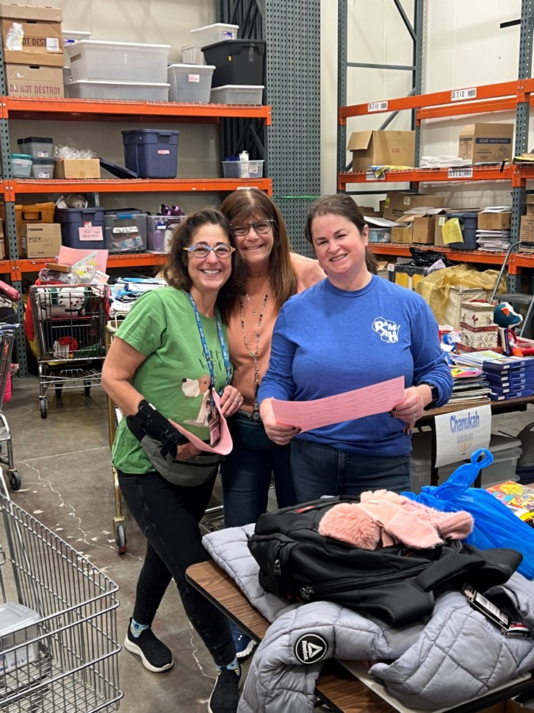
Gift Selection leadership team

Slide 13
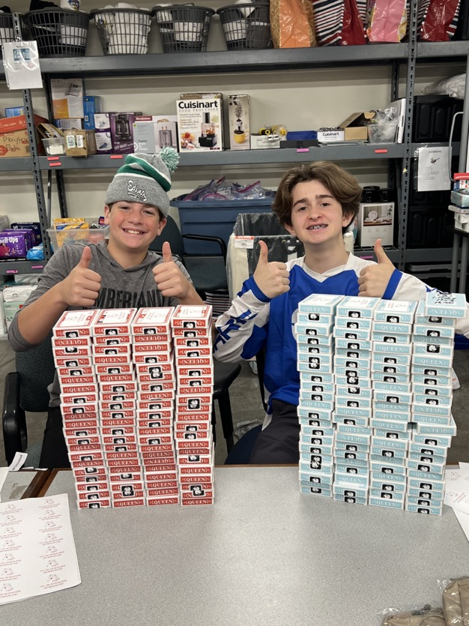
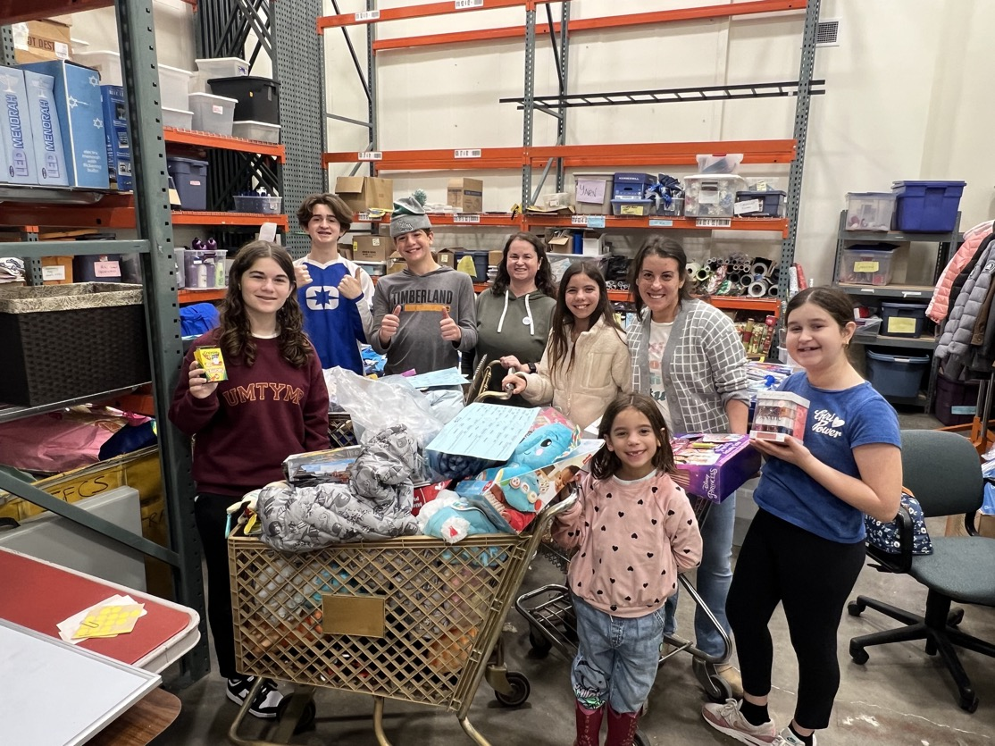
Gift Selection

Slide 14

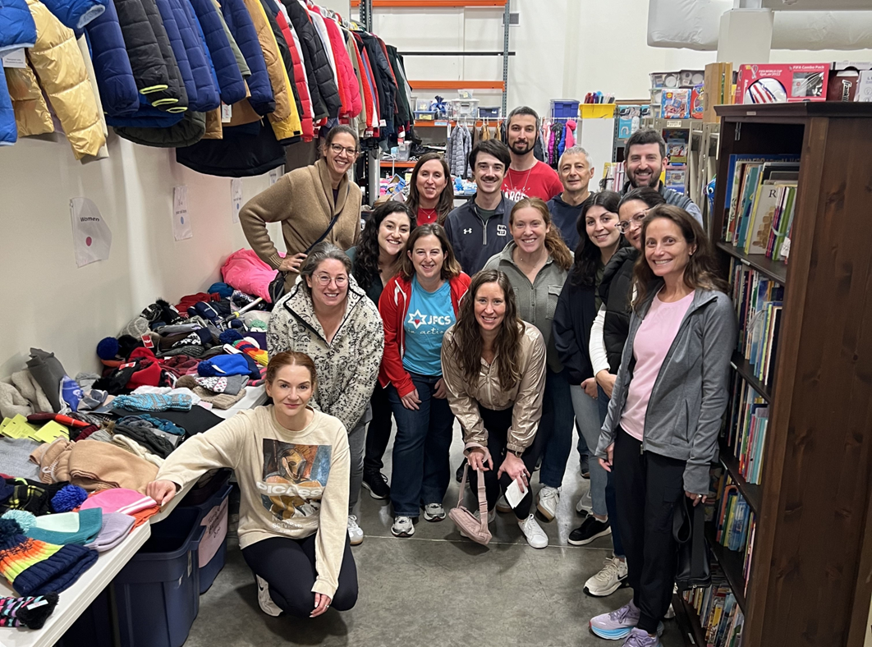
Target Jewish Employee Resource Group (ERG)
Gift Selection

Slide 15
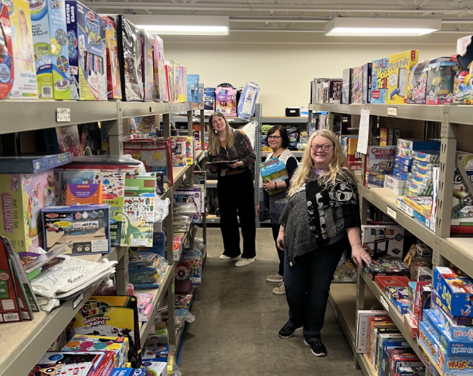
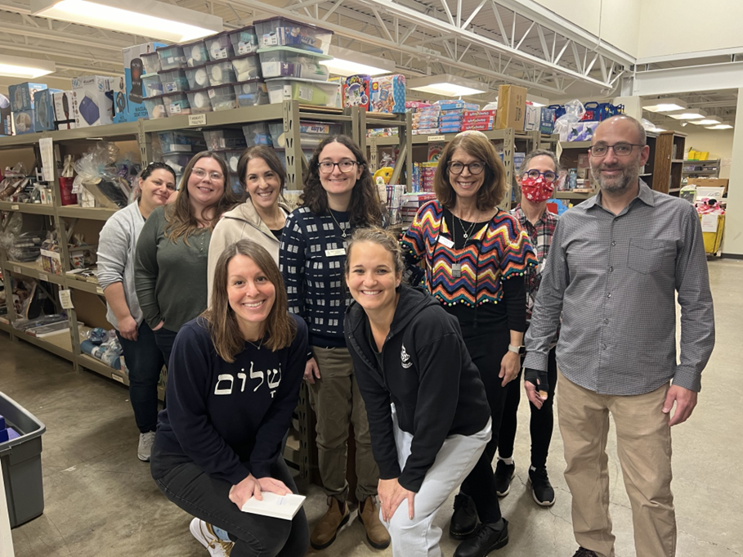
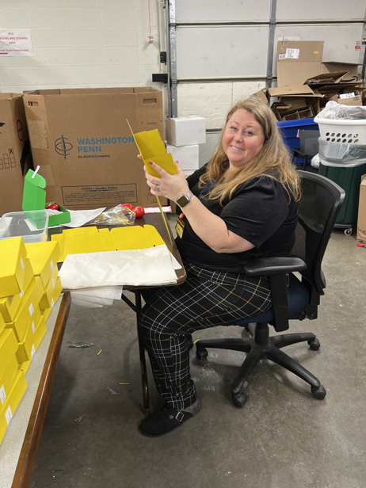

JFCS ELT (executive leadership team)
Gift Selection

Slide 16
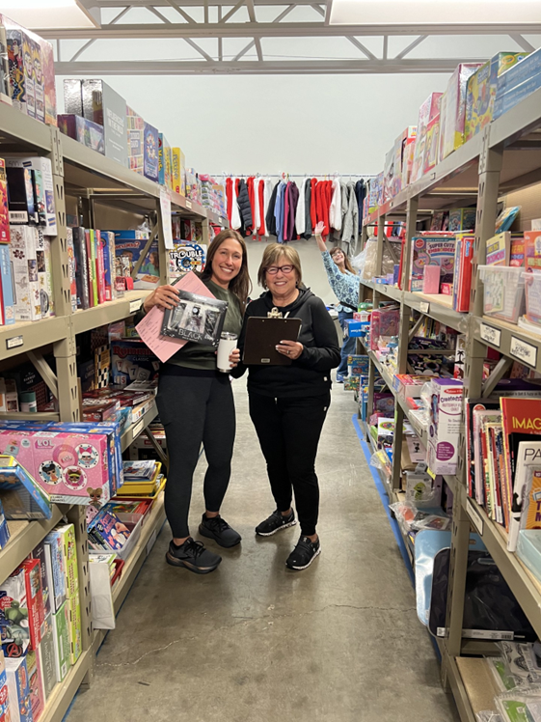
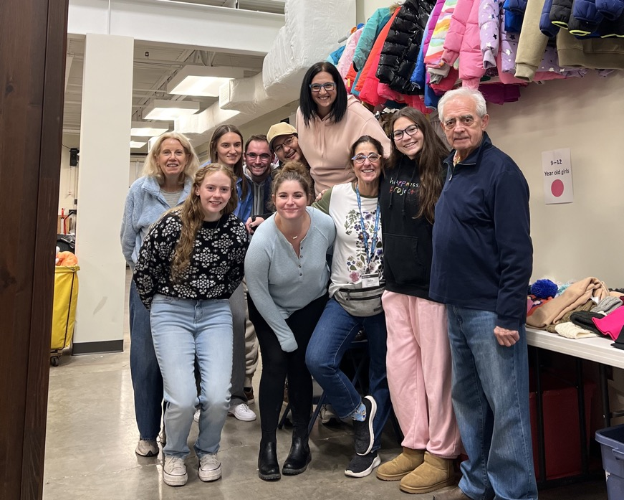
Gift Selection

Slide 17

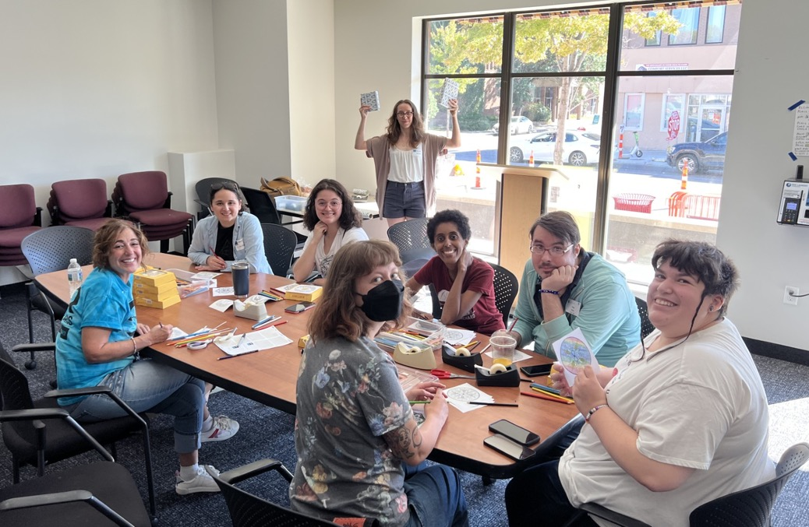

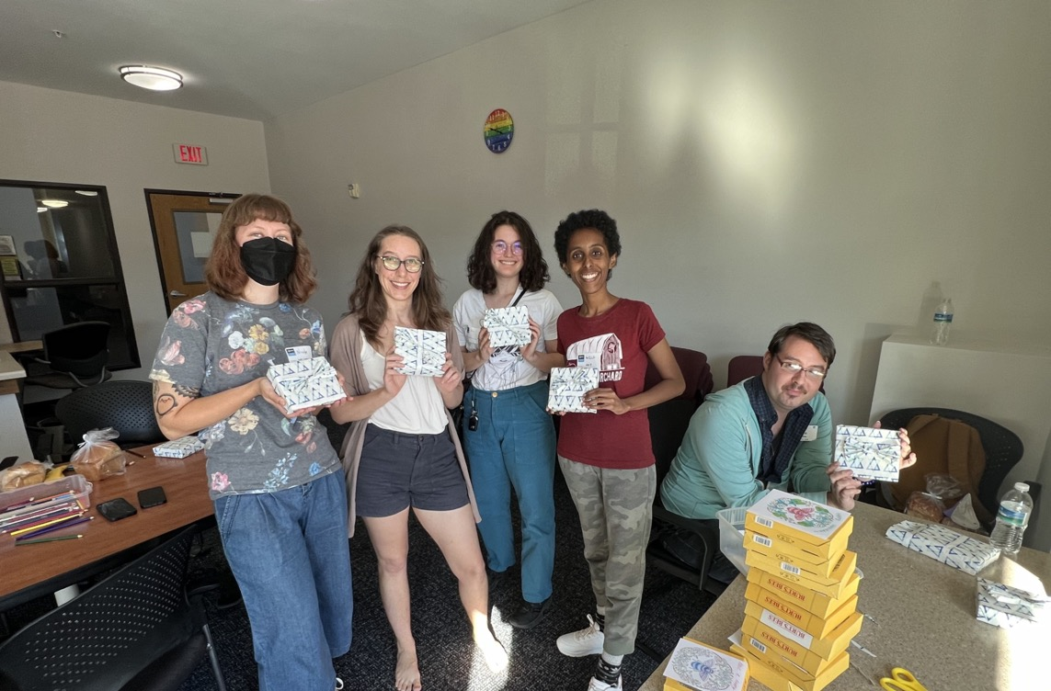

Gift Wrap

Slide 18

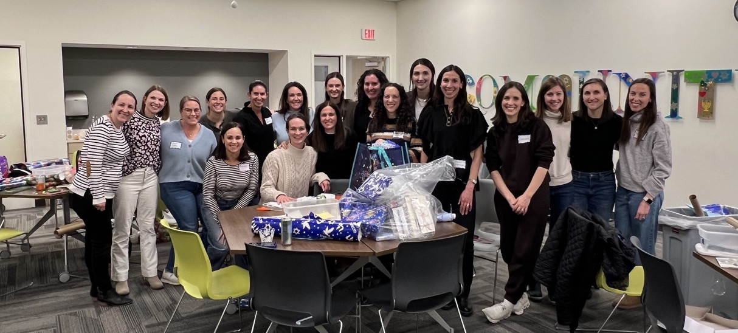
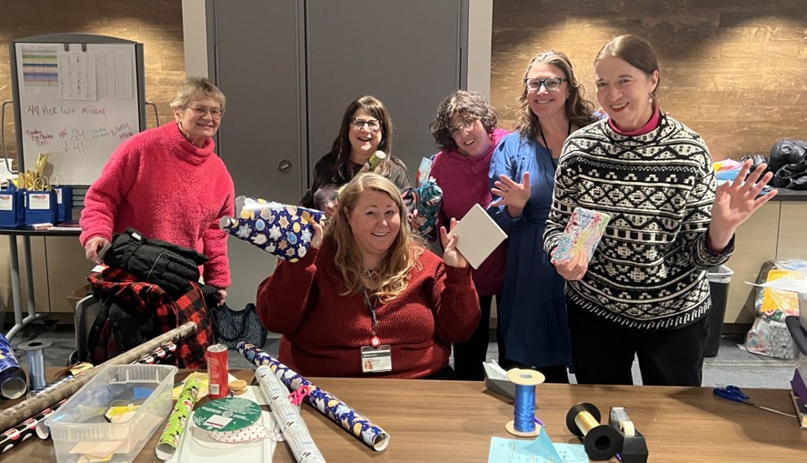

Gift wrap

Slide 19

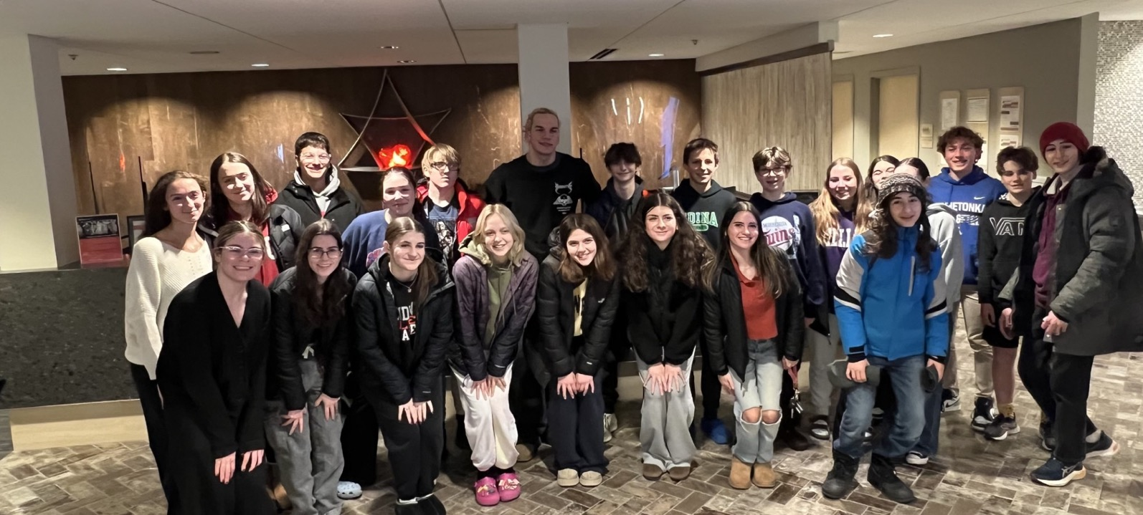
Gift wrap
TIPTY (Temple Israel Program for Temple Youth)
gift wrap event!

Slide 20

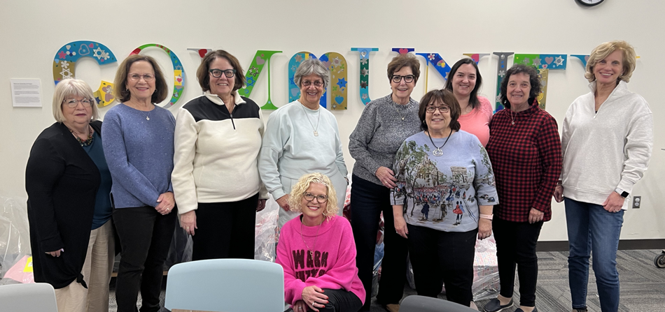

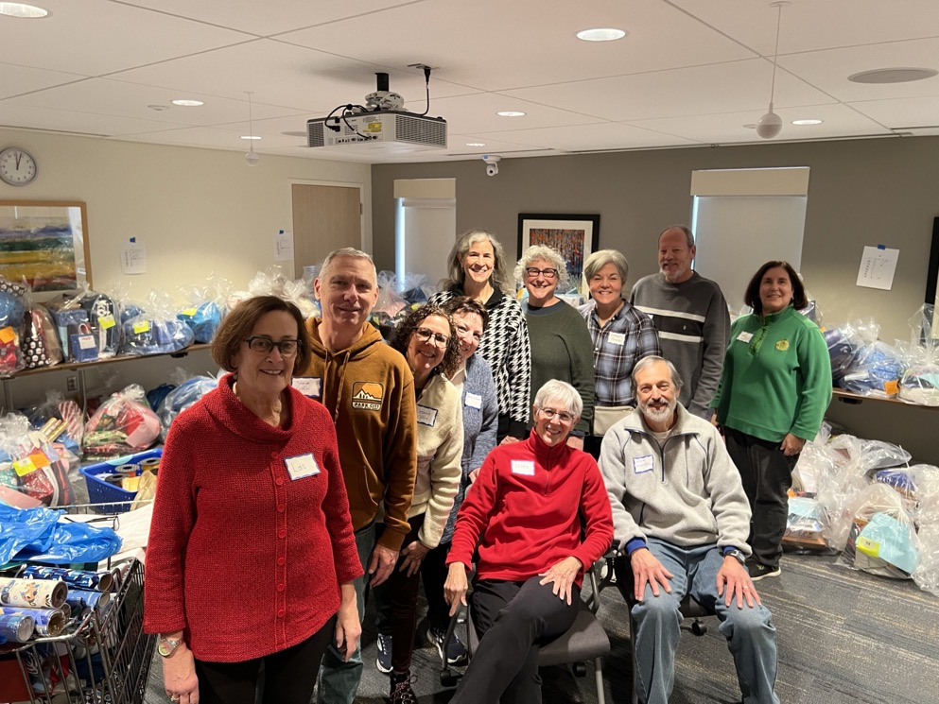

The Adath Atid (50’s+ group)
Gift wrap

Slide 21

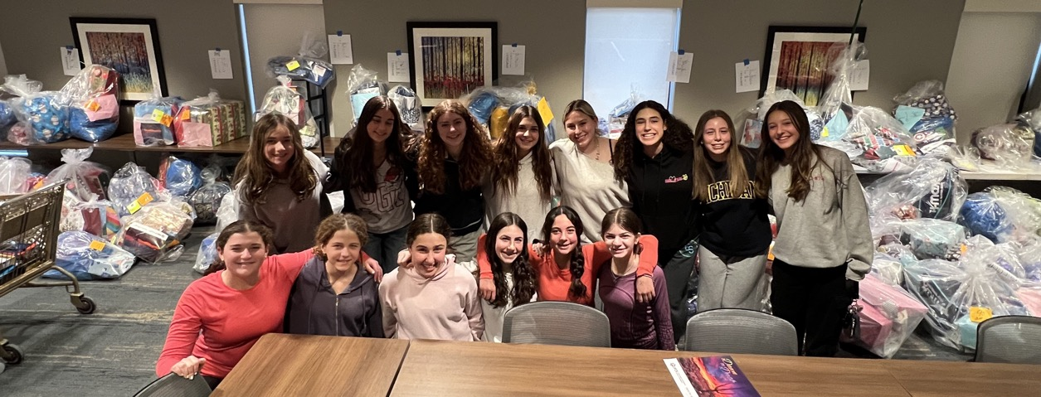
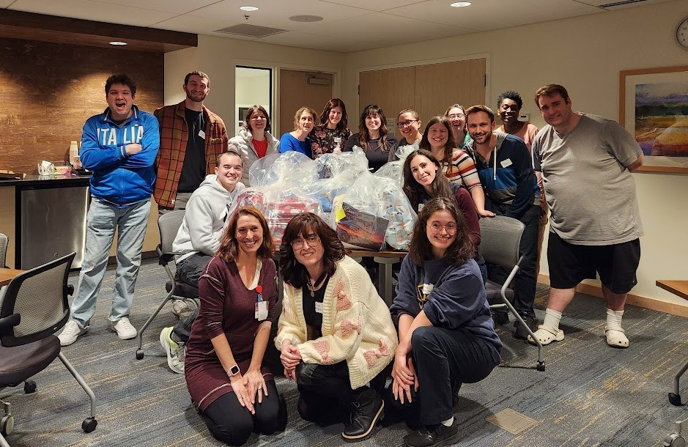

Gift Wrap

Slide 22
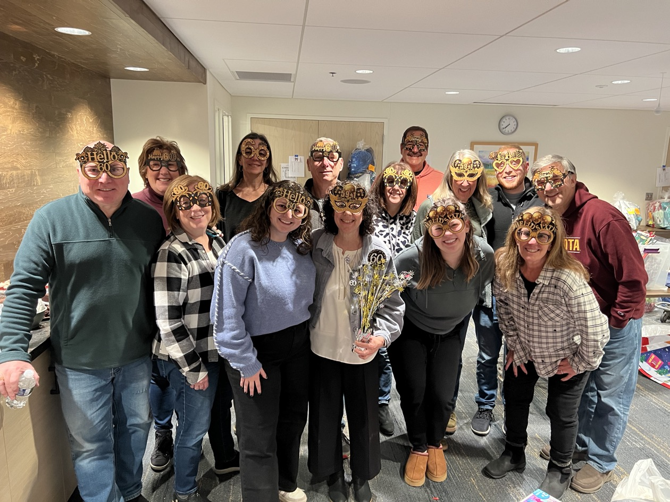

What better way to celebrate your birthday than gathering friends and family to wrap gifts!
Gift Wrap

Slide 23
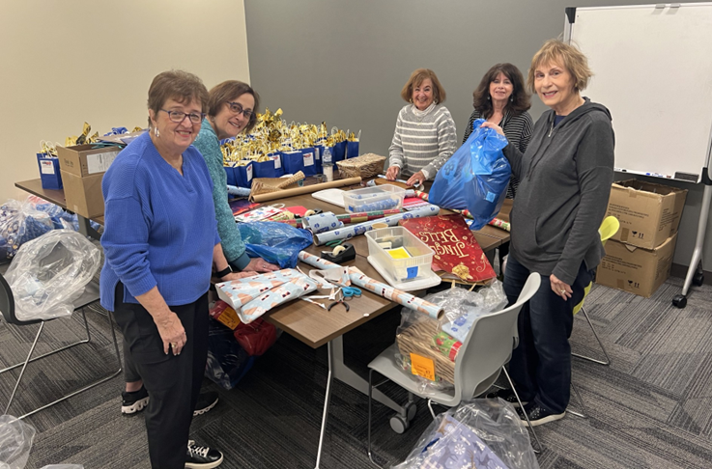

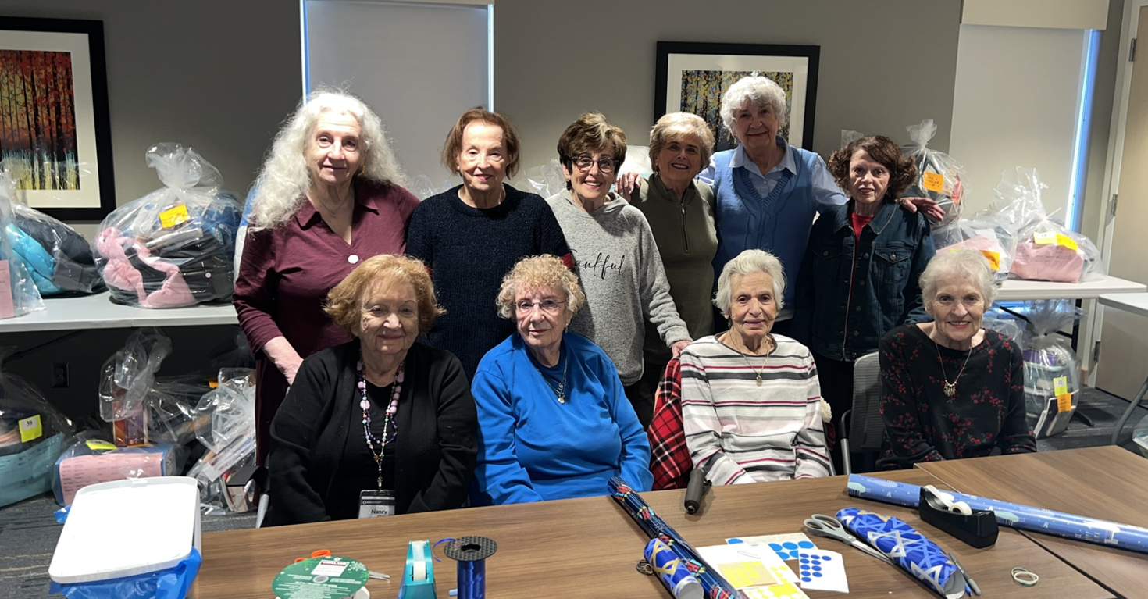
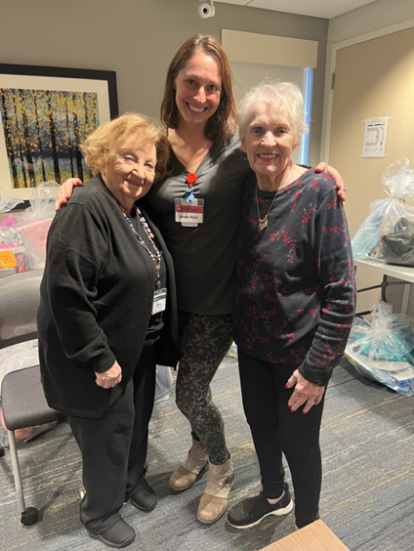
Gift Wrap

Slide 24
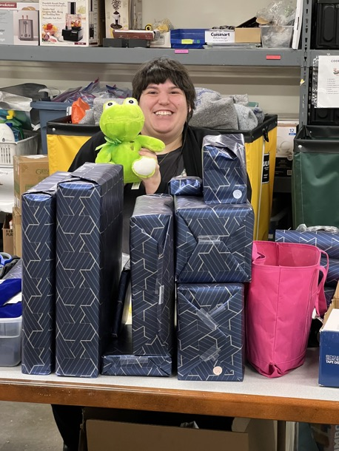
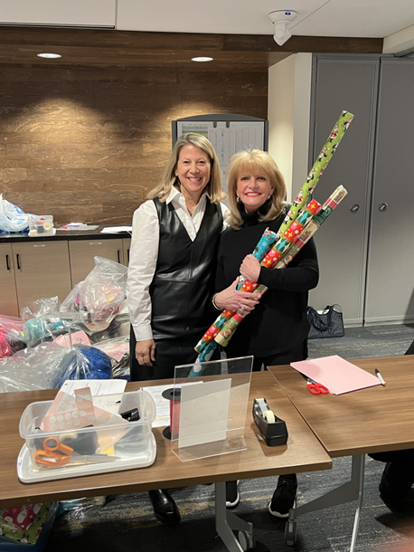


Gift Wrap

Slide 25



Delivery leadership team

Slide 26



Delivery

Slide 27




Case Managers delivering!

Slide 28

2024 winter holidays breakdown
437 referrals which provided to 813 individuals
Family = 218 family referrals
Caring Connections = 49 individuals
Hospitals =6 referrals for 71 individuals
Memory Cafe = 7 referrals for 14 individuals
Mindy's clients (seniors) = 92 referrals for 112 individuals
20 Adopt-A-Family experiences
14 delivery visitors

